Slide 1
EULER’S PHI ALGORITHM

Slide 2
Euler’s phi algorithm
Also known as totient function, denoted by Φ) is a function on natural numbers that gives the count of positive integers coprime with the corresponding natural number.
Euler’s phi function φ is multiplicative. In other words, if gcd(m, n) = 1 then φ(mn) = φ(m) φ(n).

Slide 3

Euler’s phi algorithm
The value $\left.φ(n\right)$ can be obtained by Euler’s formula:
Let be the prime factorization of n. Then

Slide 4
Euler’s phi algorithm
int phi[] = new int[n+1];
for(int i=2; i <= n; i++)
phi[i] = i; //phi[1] is 0
for(int i=2; i <= n; i++)
if( phi[i] == i )
for(int j=i; j <= n; j += i )
phi[j] = (phi[j]/i)*(i-1);

Slide 5
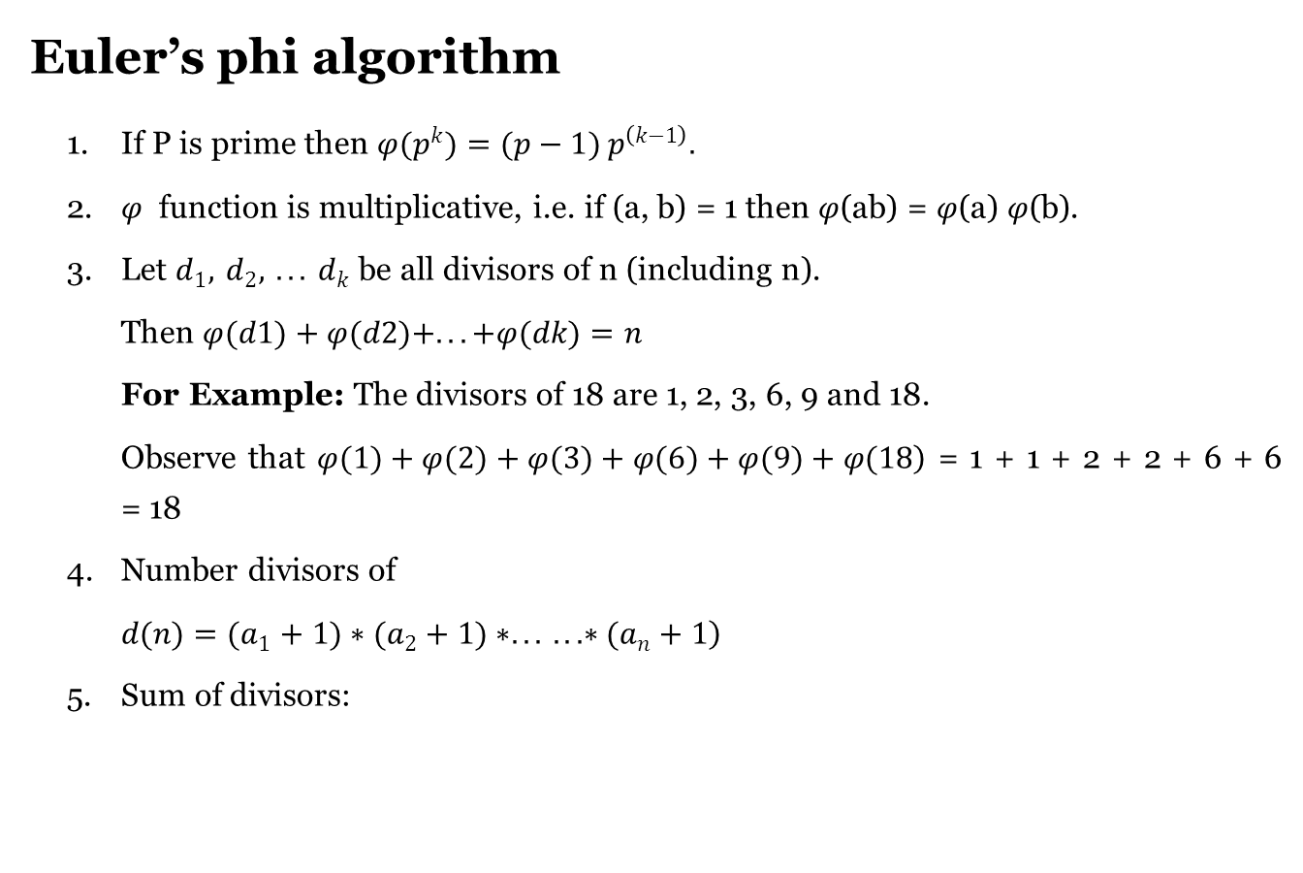
Euler’s phi algorithm
1. If P is prime then $φ(p^{k})=(p−1) p^{\left(k−1\right)}.$
2. $φ$ function is multiplicative, i.e. if (a, b) = 1 then $φ$(ab) = $φ$(a) $φ$(b).
3. Let $d_{1}, d_{2}, ... d_{k}$ be all divisors of n (including n).
Then $φ(d1)+φ(d2)+...+φ(dk)=n$
For Example: The divisors of 18 are 1, 2, 3, 6, 9 and 18.
Observe that $\left.φ(1)+φ(2)+φ(3)+φ(6)+φ(9)+φ(18\right)$ = 1 + 1 + 2 + 2 + 6 + 6 = 18
4. Number divisors of
$\left.d(n)=(a_{1}+1)∗(a_{2}+1)∗... ...∗(a_{n}+1\right)$
5. Sum of divisors:

Slide 6
Strobogrammatic number
• Rotationally symmetric
• Appears same when rotated 180 degrees
• Appears same right-side up and upside down

Slide 7
Strobogrammatic number
• 0 after 180° rotation : (0 → 0)
• 1 after 180° rotation : (1 → 1)
• 8 after 180° rotation : (8 → 8)
• 6 after 180° rotation : (6 → 9)
• 9 after 180° rotation : (9 → 6)

Slide 8
Strobogrammatic number
Define a function find Strobogrammatic(), this will take n,
Define an array ret
if n & 1 is non-zero, then −
• insert "0" at the end of ret
• insert "1" at the end of ret
• insert "8" at the end of ret
Otherwise
• insert blank string at the end of ret

Slide 9
for n > 1, update n := n - 2, do −
Define an array temp
for initialize i := 0, when i < size of ret, update (increase i by 1), do −
• s := ret[i]
if n > 3, then
• insert "0" + s + "0" at the end of temp
• insert "1" + s + "1" at the end of temp
• insert "8" + s + "8" at the end of temp
• insert "6" + s + "9" at the end of temp
• insert "9" + s + "6" at the end of temp
ret := temp
return ret

Slide 10
From the main method, do the following −
• ret := 0
Define an array v
for initialize i := size of low, when i <= size of high, update (increase i by 1), do −
• v := find Strobogrammatic(i)
for initialize j := 0, when j < size of v, update (increase j by 1), do −
• ret := ret + (1 when length of v[j] > length of low AND length of high > length of v[j])
return ret

Slide 11
Thank You …

